Slide 1

Car counter
Electronic Shop Practice ECE 3100 Department of Electrical & Computer Engineering Rajshahi University of Engineering & Technology

Slide 2

Team members
Mahbuba Habib (1810026)
Deba Priyo Guha(1810027)
Md. Alif (1810028)

Slide 3

Theme
The project idea is a “Car Counter”. Here we will check the number of cars that are going in or coming out from a certain place. We will be able to check the remaining cars in a certain road or area.

Slide 4
Features
* Taking live video as input .
* Process images of a road.
* Count cars

Slide 5
Languages and Library
Python
OpenCV (Open Source Computer Vision Library)

Slide 6
Hardware
Raspberry Pi
Raspberry Pi Camera Module
Connectors

Slide 7
Procedure
Record the video of a road with Camera Module.
Track the vehicles with OpenCV.
Process their images.
Count their numbers.
Display the number.

Slide 8
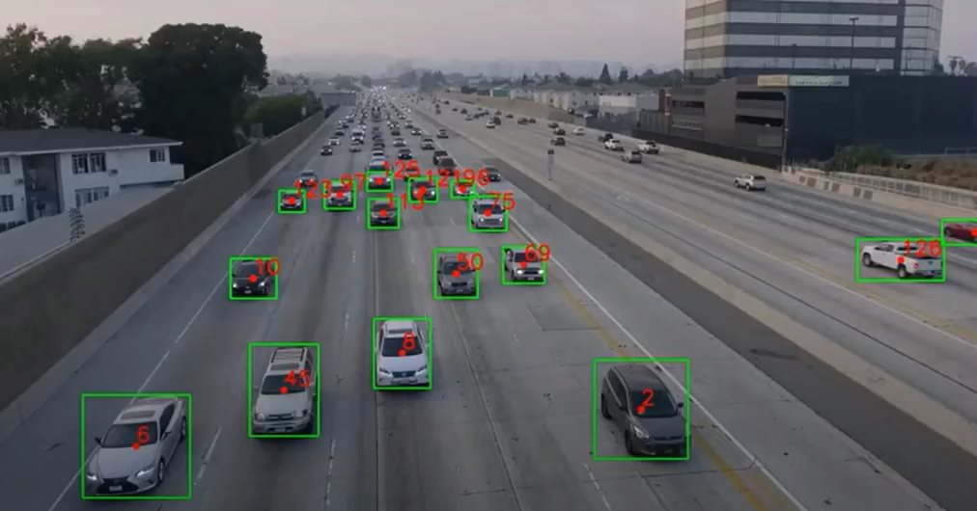
Video

Slide 9
Scope
* Helps traffic police
* Maintaining records
* Traffic surveillance control

